Slide 1
Multimodal Machine Learning
Compiled by Khadijah Ahmed and Debayan Mukhopadhyay, Department of Computer Science and Engineering, University of Calcutta

Slide 2
Contents
Topic | Slide Number
Introduction | 3 - 10
Representation | 11 - 26
Alignment | 27 - 31
Reasoning | 32 - 48
Generation | 49 - 59
Transference | 60 - 67
Quantification | 68 - 76

Slide 3
Introduction
Multimodal
Examples
The science of heterogeneous & connected data. In case of heterogeneous modalities, information is present in different modalities and shows diverse qualities, structures & representations.
Modality
Language: Words and sentences used in communication.
Vision: Visual cues like images or gestures.
Speech: Auditory signals and tone of voice.
The way in which something is represented.

Slide 4
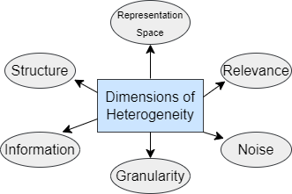
Dimensions of Heterogeneity
Dimensions of heterogeneity reflect the varied characteristics that must be managed when integrating multiple modalities.

Slide 5
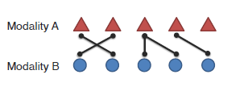
Interconnected Modalities
Connections
Cross-modal Interactions
Which elements are connected and why?
How are the connected elements interacting during inference?

Slide 6
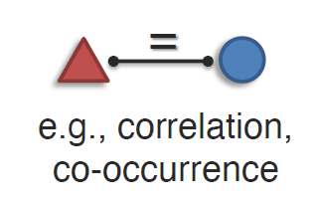
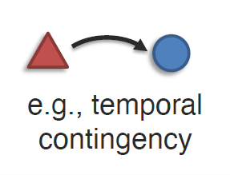
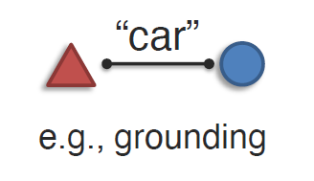
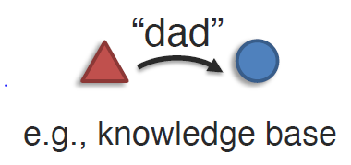
Connections
CONNECTIONS
Statistical
Semantic
Association
Dependency
Correspondence
Relationship

Slide 7
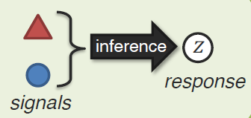
Cross-modal Interactions
Interactions happen during Inference.
Crossmodal interactions involve the integration and influence of different sensory modalities on one another, allowing for enhanced perception, understanding, and decision-making by combining information from multiple sources.

Slide 8
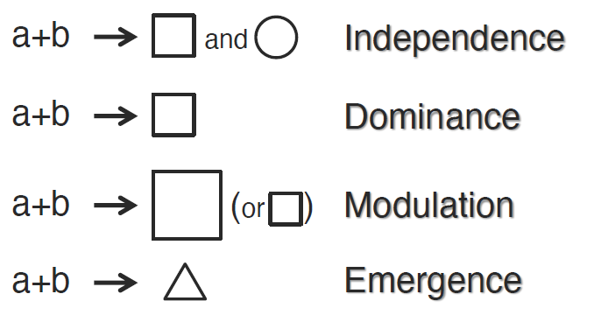
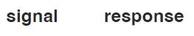
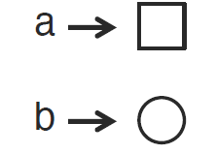
Types of Multimodal Communication:
Types of multimodal communication include independence, where each modality functions separately; dominance, where one modality leads; modulation, where one modality influences another; and emergence, where new meanings arise from the combination of modalities.

Slide 9
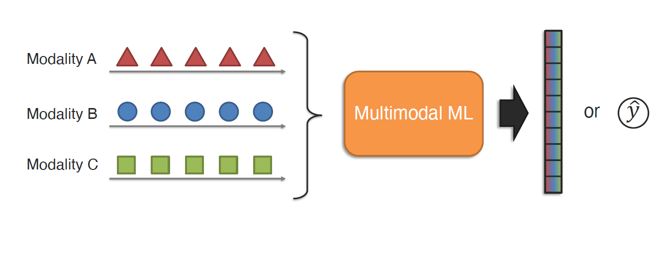
Multimodal Machine Learning
It is the study of computer algorithms that learn and improve through the use and experience of data from multiple modalities.

Slide 10
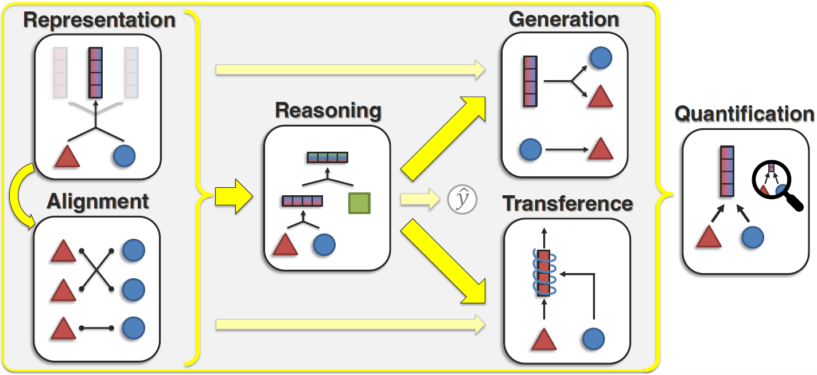
Core Challenges for Multimodal Learning
Core challenges in multimodal learning include representation, alignment, reasoning, generation, transference, and quantification, each addressing a unique aspect of integrating and leveraging diverse data modalities.

Slide 11
Challenge 1: Representation

Slide 12
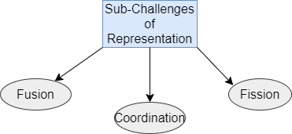
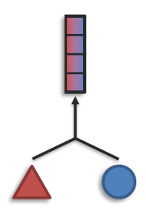
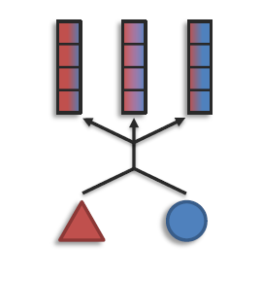
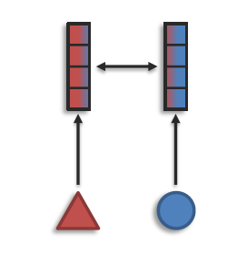
Learning effective representations in multimodal learning involves overcoming sub-challenges like fusion to combine data, coordination to align information across modalities, and fission to separate modality-specific features.

Slide 13
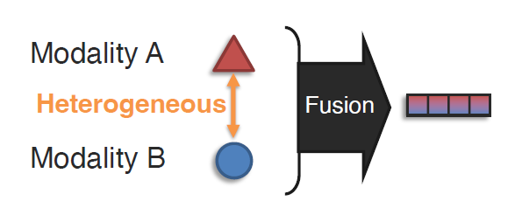
Representation Fusion

Slide 14
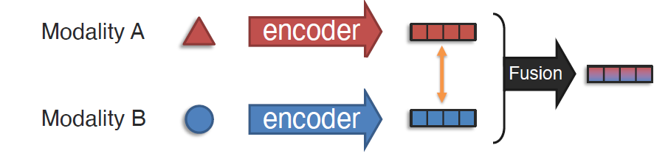
To learn a joint representation that models cross-modal interactions between individual elements of different modalities.

Slide 15
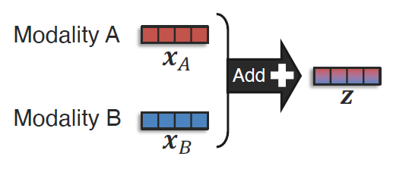
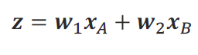
Additive Fusion
The features of modality A and modality B are combined through simple addition, where each modality contributes independently to the final representation.

Slide 16
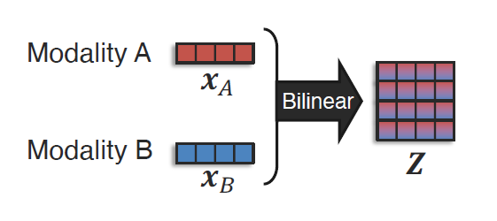
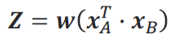
Multiplicative Fusion
Features from modalities A and B are combined multiplicatively using a bilinear operation, which takes the outer product of their feature vectors to form a matrix capturing all possible pairwise interactions between them.

Slide 17
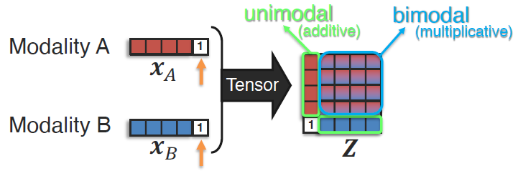
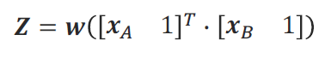
Tensor Fusion
Tensor fusion extends multiplicative interactions by creating a high-dimensional tensor that captures both the direct features of modalities A and B and their pairwise multiplicative combinations.

Slide 18
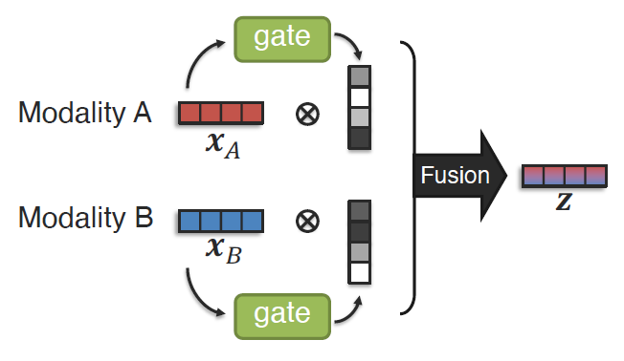
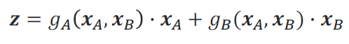
Gated Fusion
Gated fusion is a technique that uses attention mechanisms to dynamically weigh the contribution of each modality before fusing them, allowing the model to focus more on the relevant features from each modality for a given task.
g_{A} and g_{B} are attention functions.

Slide 19
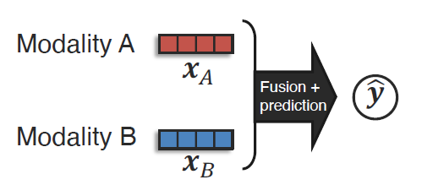
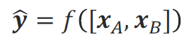
Non-linear Fusion
Nonlinear fusion combines data from multiple modalities using neural networks, like a multilayer perceptron, to learn the fusion process and either perform predictions within the same model or through a separate network.
f can be any nonlinear model

Slide 20
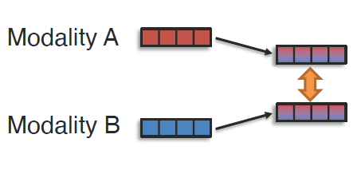
Representation Coordination

Slide 21
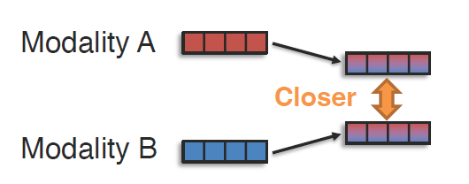
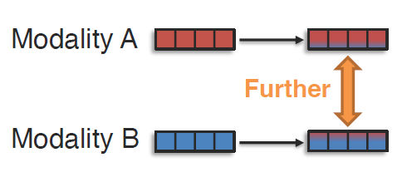
Strong Coordination
To learn multimodally-contextualised representations that are coordinated through their cross-modal interactions.
Partial Coordination

Slide 22
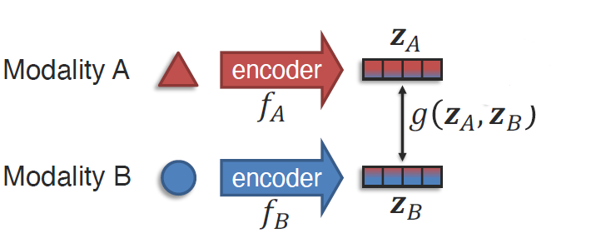
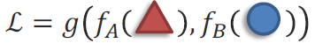
Coordination Function
Coordination functions in multimodal machine learning align and integrate features from different modalities by learning the parameters of both encoders in a way that ensures coordinated representations.
Learning with coordination function with θ_{g},θ_{fA} and θ_{fB} model parameters.

Slide 23
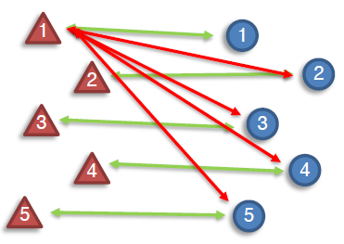
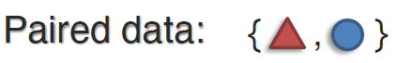
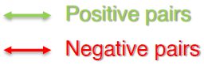
Coordination with Contrastive Learning
max{0, α + sim(z_{A},z_{B}⁺) - sim(z_{A},z_{B}⁻)
Coordination with contrastive learning does not explicitly enforce a coordination function but instead uses pairs of data to identify positive and negative examples across modalities, applying contrastive loss to bring positive pairs closer together while pushing negative pairs apart, thereby implicitly aligning representations.

Slide 24
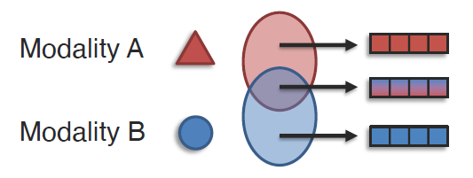
Representation Fission

Slide 25
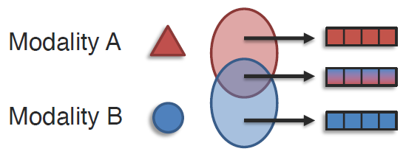
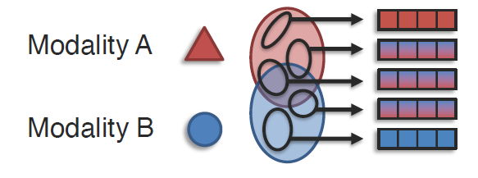
To learn a new set of representations that reflects the internal structure of the modality such as data factorisation & clustering.
Modality-level fission processes each modality independently to extract and represent its unique features.
Fine-grained fission breaks down data into detailed features, enhancing the granularity and understanding of multimodal interactions.

Slide 26
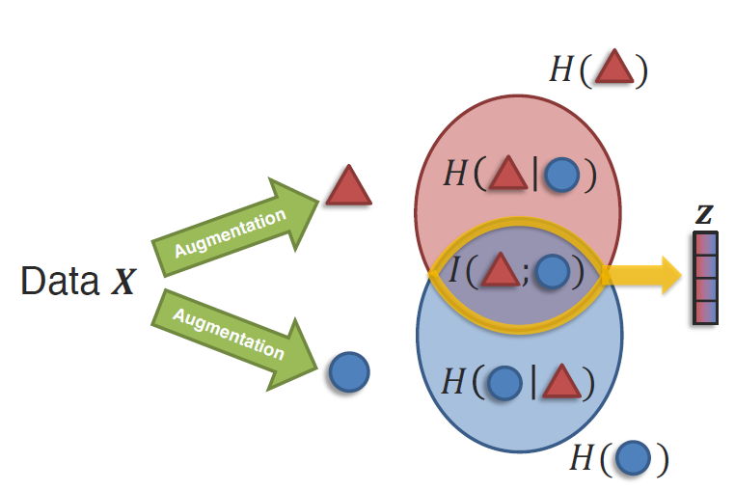
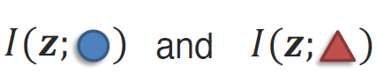
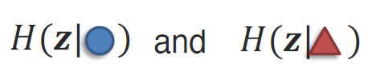
Fission with Self-Supervised Learning
Mutual Information:
Entropy:
Fission with self-supervised learning separates multimodal data into distinct features by minimizing entropy(H) and maximizing mutual information(I), helping the model learn disentangled and informative representations from unlabeled data.

Slide 27
Challenge 2: Alignment

Slide 28
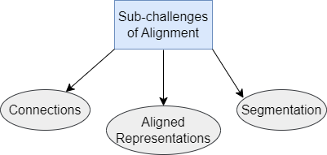
To identify and model cross-modal connections between elements across multiple modalities, ensuring consistency and coherence based on the underlying data structure.

Slide 29
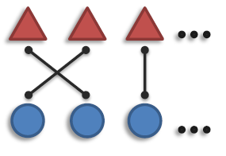
Connections
Connections, or explicit alignments, involve identifying and modeling direct links between elements across multiple modalities to understand why they should be connected. This process captures various types of relationships, including statistical associations, dependencies, and semantic correspondences, to ensure coherent cross-modal integration.

Slide 30
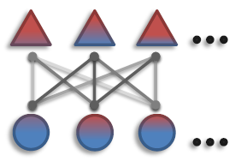
Aligned Representation
Aligned representations, also known as implicit alignment, aim to model all cross-modal connections and interactions to learn richer and more integrated representations. This approach leverages self-alignment techniques and learns representations over the inherent structure, capturing nuanced relationships across modalities.

Slide 31
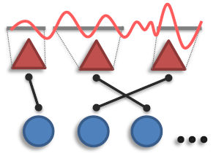
Segmentation
Segmentation addresses the challenge of handling ambiguity in determining the granularity of elements during alignment across modalities. It involves refining the segmentation process to ensure each element is accurately represented, allowing for precise cross-modal interactions and coherent integration.

Slide 32
Challenge 3: Reasoning

Slide 33
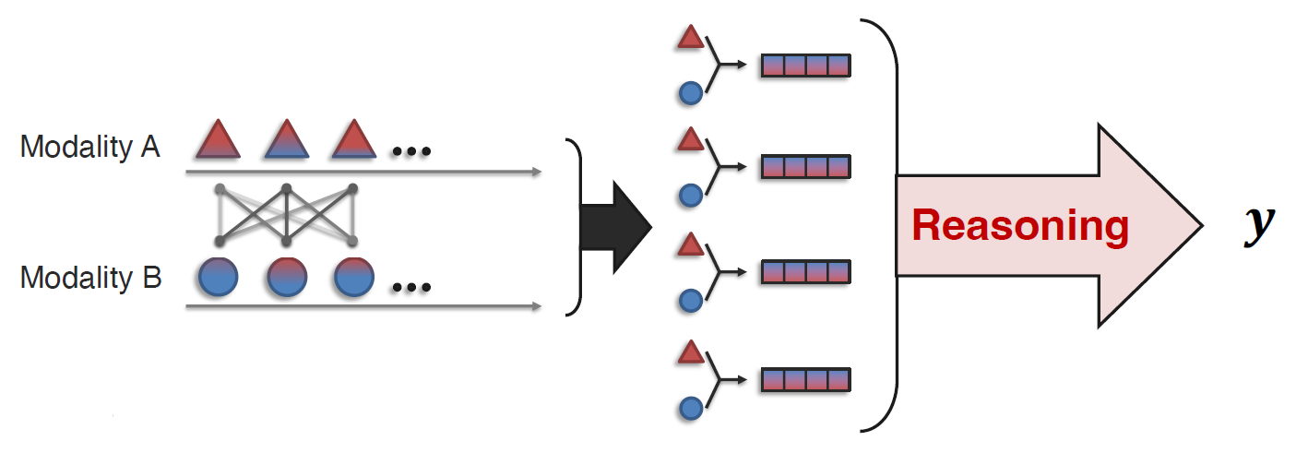
Reasoning in multimodal learning involves combining knowledge through multiple inferential steps, leveraging multimodal alignment and the underlying problem structure to derive coherent and accurate insights.

Slide 34
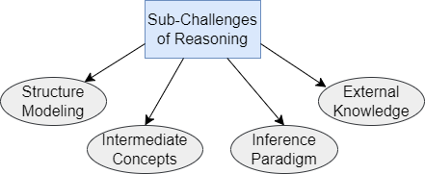
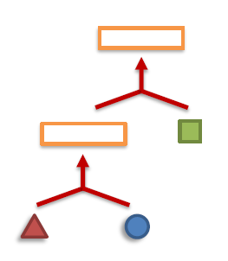

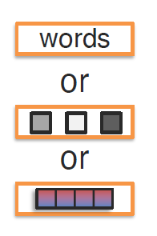

Sub-Challenges of Reasoning

Slide 35

This graph illustrates the interplay between concepts, inference, and structure in multimodal reasoning, highlighting how these axes contribute to integrating and deriving insights from diverse data sources.

Slide 36
Structure Modeling
To define/learn the relationships over which composition occurs.

Slide 37

Single-step Modeling
Single-step structure modeling involves directly capturing relationships or dependencies within a single instance or immediate context. This approach focuses on straightforwardly modeling interactions either within a single modality or between modalities without complex layering.

Slide 38

Multistep Modeling
Multistep structure modeling involves capturing complex relationships through multiple layers, including temporal, hierarchical, interactive, and discovery-based approaches to build a comprehensive understanding of data.

Slide 39

Temporal Structure
Temporal structure modeling enables cross-modal interactions across time, integrating multiview sequences and evolving multimodal memory using parameterization methods such as transformers, RNNs, or key-value memory.

Slide 40

Hierarchical Structure
Hierarchical structure modeling organizes data into layered abstractions, leveraging syntactic language structure to capture varying levels of complexity.

Slide 41

Interactive Structure
Interactive structure modeling captures dynamic interactions between modalities or within a modality over multiple steps, where actions at previous timestamps influence future states, often leveraging reinforcement learning techniques.

Slide 42

Structure Discovery
Structure discovery involves fully learning the data structure through optimization, defining basic representation and fusion building blocks (such as ReLU, layer normalization, convolution, concatenation, and attention), and using neural architecture search to uncover new patterns and relationships through iterative exploration.

Slide 43
Intermediate Concepts
Intermediate concepts are the parameterization of individual multimodal concepts in the reasoning process.

Slide 44

Intermediate concepts in reasoning involve neuro-symbolic approaches, using hand-crafted concepts from domain knowledge and leveraging syntactic structure to enhance understanding.
Intermediate concepts in reasoning can be either dense, derived from neural network features, or interpretable, based on domain knowledge and syntactic language structures. Dense concepts capture detailed patterns, while interpretable concepts facilitate explicit reasoning processes.

Slide 45
Inference Paradigm
To find out how increasingly abstract concepts are inferred from individual multimodal evidences through layered and integrated reasoning.

Slide 46


Logical Inference
Are they in a restaurant and are they all boys?
Logical inference derives abstract concepts from multimodal evidence using formal logic processes, focusing on simple statements and conclusions. It is applied in tasks like Visual Question Answering (VQA) using differential logical operators to make deductions from given premises.

Slide 47


Causal Inference
Causal inference determines the actual causal effect of a variable within a system by identifying and understanding cause-and-effect relationships using multimodal evidence.
Covariant Inference: Targets the variable of interest (treatment variable) and assesses its effect by removing or altering it to observe changes.
Invariant Inference: Targets irrelevant variables (confounding variables) that are similar in features to the treatment variable but do not affect the outcome; these are removed to isolate the effect of the treatment variable.

Slide 48
Knowledge
To derive knowledge through the study of inference, structure, and reasoning to understand complex relationships and insights. Knowledge can be derived from external sources like multimodal knowledge graphs or some other unstructured formats.

Slide 49
Challenge 4: Generation

Slide 50


To learn a generative process to produce new data or content by synthesizing multimodal representations, capturing cross-modal interactions to ensure coherent and contextually relevant outputs.

Slide 51
Translation

Slide 52

Translation involves converting content from one modality or language to another while preserving meaning and context. This requires aligning and understanding multimodal inputs to generate accurate and contextually appropriate translations.
“An armchair in the shape of an avocado.”

Slide 53

DALL-E
DALL·E excels in text-to-image translation at scale by coordinating via supervised translation to capture corresponding cross-modal interactions. It involves a three-step process: first, a discrete VAE encodes images into a visual codebook, followed by an autoregressive transformer to model the relationship, and finally, generation of images based on the learned representations.

Slide 54
Summarization

Slide 55

Summarization involves reducing multimodal data by condensing it while emphasizing the most salient information. It integrates key points from various modalities into a coherent and concise summary that highlights essential content.

Slide 56

Video Summarization
Video summarization involves fusion via joint representation to capture complementary cross-modal interactions, integrating various data sources into a coherent summary. Generative approaches in summarization aim for abstractive content, producing concise and meaningful overviews of the original video.

Slide 57
Creation

Slide 58

Creation involves simultaneously generating multiple modalities, such as text, images, or audio, to enhance information content while ensuring coherence both within and across modalities. This process requires synthesizing diverse inputs to produce innovative, contextually relevant, and integrated outputs.

Slide 59

Factorized Generation
Factorized generation in digit generation uses factorized representations to expand complementary cross-modal interactions, enhancing the generative model's ability to produce accurate and diverse digit outputs.

Slide 60
Challenge 5: Transference

Slide 61

To transfer knowledge between modalities to enhance understanding in a primary modality, especially when it is noisy or lacks sufficient resources.

Slide 62

Transfer via Pretrained Model

Slide 63

Transfer via pretrained models involves using knowledge from large-scale models to improve tasks in a primary modality, even with minimal data. Techniques like prefix tuning and representation tuning help generalize across various tasks and modalities, especially useful for low-resource settings.

Slide 64

Co-learning via Representation

Slide 65

Co-learning via representation involves transferring knowledge from a secondary to a primary modality by sharing representation spaces between them. This includes methods like aligning word embeddings for zero-shot visual classification, enabling cross-modal learning and inference.

Slide 66

Co-learning via Generation

Slide 67

Co-learning via generation transfers knowledge by using the secondary modality as the target for generating outputs in the primary modality. This method integrates information from both modalities, enhancing learning while relying on the secondary modality to guide the generation process.

Slide 68
Challenge 6: Quantification

Slide 69

Quantification involves measuring and evaluating the contribution and effectiveness of each modality within a multimodal learning framework. This challenge focuses on developing methods to quantify the influence and importance of different modalities, ensuring the model uses the most relevant information to improve performance. It also addresses the need for robust metrics to assess the quality and reliability of multimodal models.

Slide 70

Heterogeneity

Slide 71

Heterogeneity involves measuring the diverse characteristics of multimodal datasets, such as structure, representation space, and noise levels. It aims to address modality biases, noise robustness, and the influence of these factors on learning outcomes, ensuring fair and effective model performance across different modalities.

Slide 72

Cross-modal Interactions

Slide 73


Cross-modal interactions involve measuring and evaluating the various connections and interactions between modalities within multimodal datasets and trained models. This includes identifying both the overall presence and specific types of cross-modal connections. The goal is to assess how well models interpret and leverage these interactions to enhance learning and performance.

Slide 74

Multimodal Learning Process

Slide 75

The multimodal learning process focuses on understanding the complexities and optimization issues that arise when integrating heterogeneous data. It addresses why adding more modalities does not always improve model performance, often due to factors like conflicting signals, varying data quality, and alignment issues between modalities.

Slide 76

Overcoming Optimization Challenges
Compute the Overfitting-to-Generalization Ratio (OGR) to assess the gap between training and validation loss for each modality, guiding how much to train each modality to balance overfitting and generalization.
Simultaneously train unimodal networks to estimate OGR for each modality. Reweight the multimodal loss using these unimodal OGR values to better balance generalization and overfitting rates across different modalities.

Slide 77
Thank You!

